Slide 1
Strava & Weather Is there a correlation?
DS Group 7
Pieter, Luigi, Julius, Jasper & Ingmar

Slide 2
Overview
Intro to Strava
Project aim
Design plan
Results
Conclusion

Slide 3
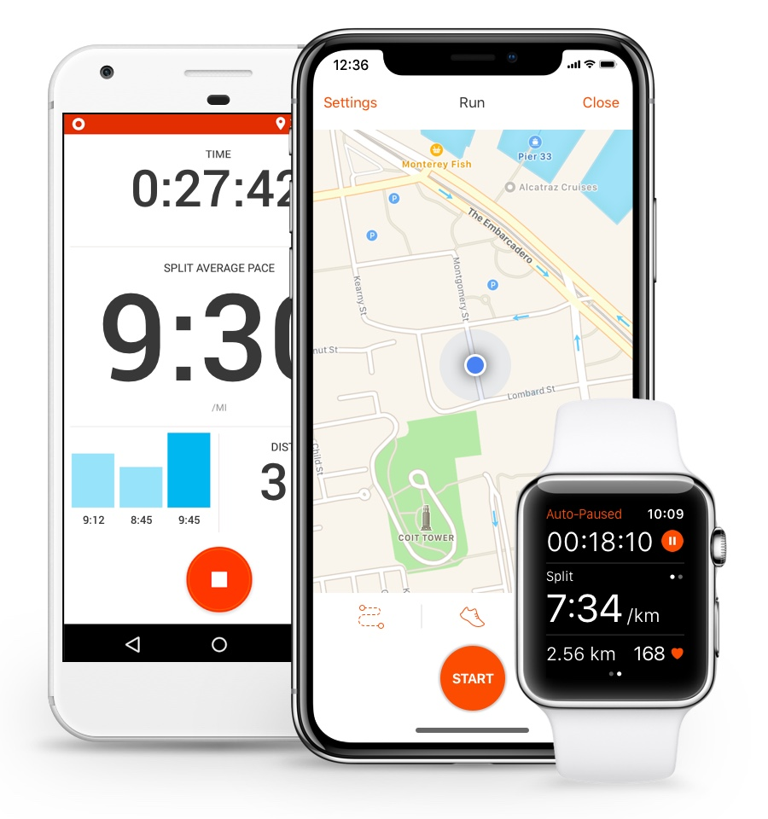
Intro to Strava
Intro to Strava
Project aim
Design plan
Results
Conclusion
Activity tracker
Segments
Leaderboards
42 million users worldwide

Slide 4
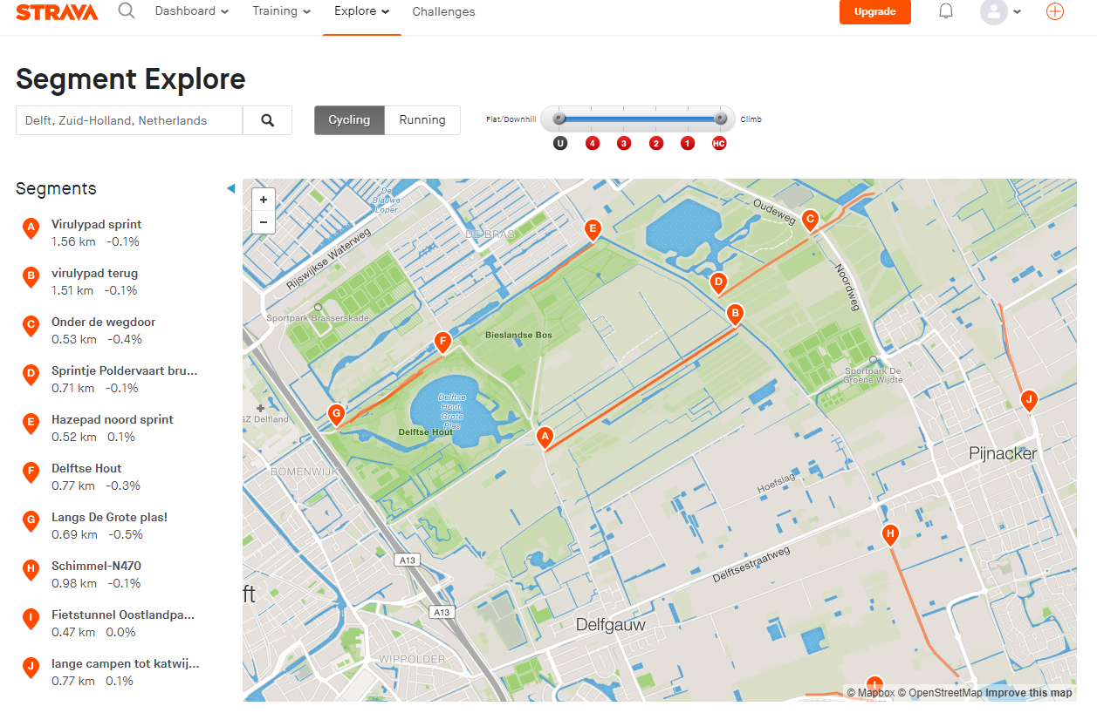
Intro to Strava
Project aim
Design plan
Results
Conclusion

Slide 5
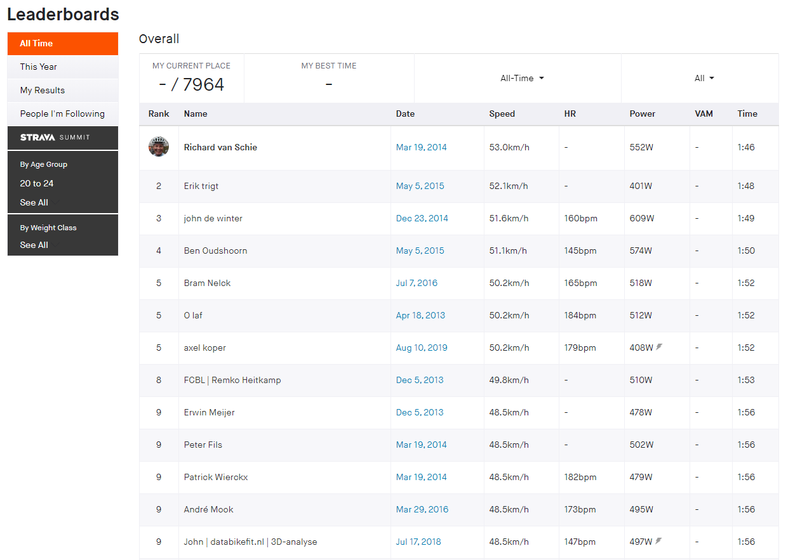
Intro to Strava
Project aim
Design plan
Results
Conclusion

Slide 6

Project Aim
Intro to Strava
Project aim
Design plan
Results
Conclusion
Find correlation between weather and places where Strava users cycle

Slide 7
Constraints
Intro to Strava
Project aim
Design plan
Results
Conclusion
Not all cyclists use Strava
Strava’s popularity over time
Defining a good weather scoring is difficult
Amount of requests

Slide 8
Design plan
Intro to Strava
Project aim
Design plan
Results
Conclusion
Controller
Strava Module
Weather Module
Obtain data
Filter data
Weather score
Obtain data
Analysis
Heat maps
Base line

Slide 9

Strava Module
Intro to Strava
Project aim
Design plan
Results
Conclusion
Notes:
- Verwijs naar het plan om enorm veel API’s te maken zodat we de data snel genoeg op zouden kunnen halen.

Slide 10

Strava Module
Intro to Strava
Project aim
Design plan
Results
Conclusion
35 hours runtime
19 million datapoints → 1.5 GB csv → 175 MB parquet
1-1-2073?
Notes:
Kan niet → scale project down, naar 5x5 km grids and 3 users. 35 uur run time dit leverde 19 miljoen data punten op en als we dit opsloegen in csv kreeg je 1.5 G → dus naar parquet (file format that stores by column) omgezet. Echter zat nog veel onzin zoals een datapunt met datum als 2073 dus dat moest eruit, dan krijg je uiteindelijk dit.

Slide 11
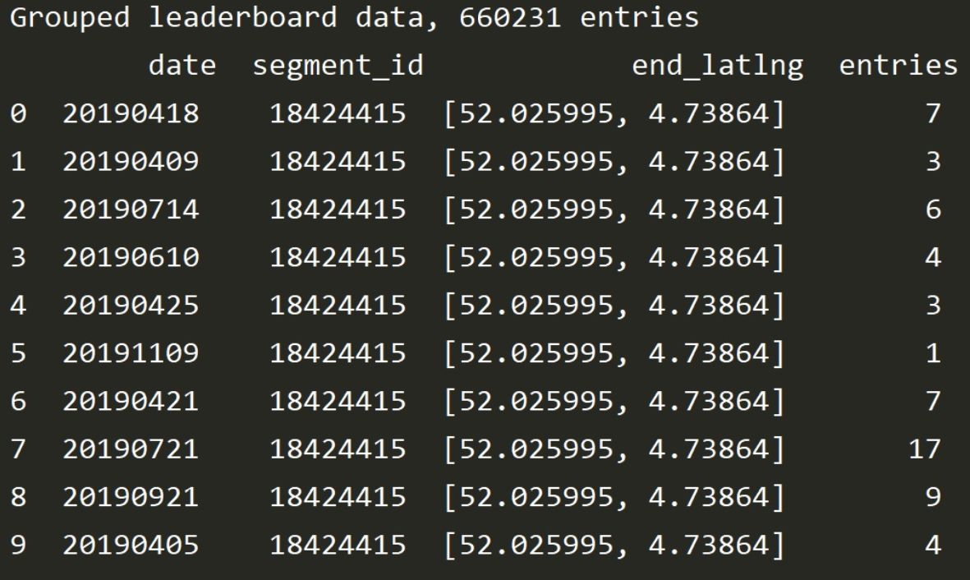
Strava Module
Intro to Strava
Project aim
Design plan
Results
Conclusion
Notes:
Showing final data

Slide 12
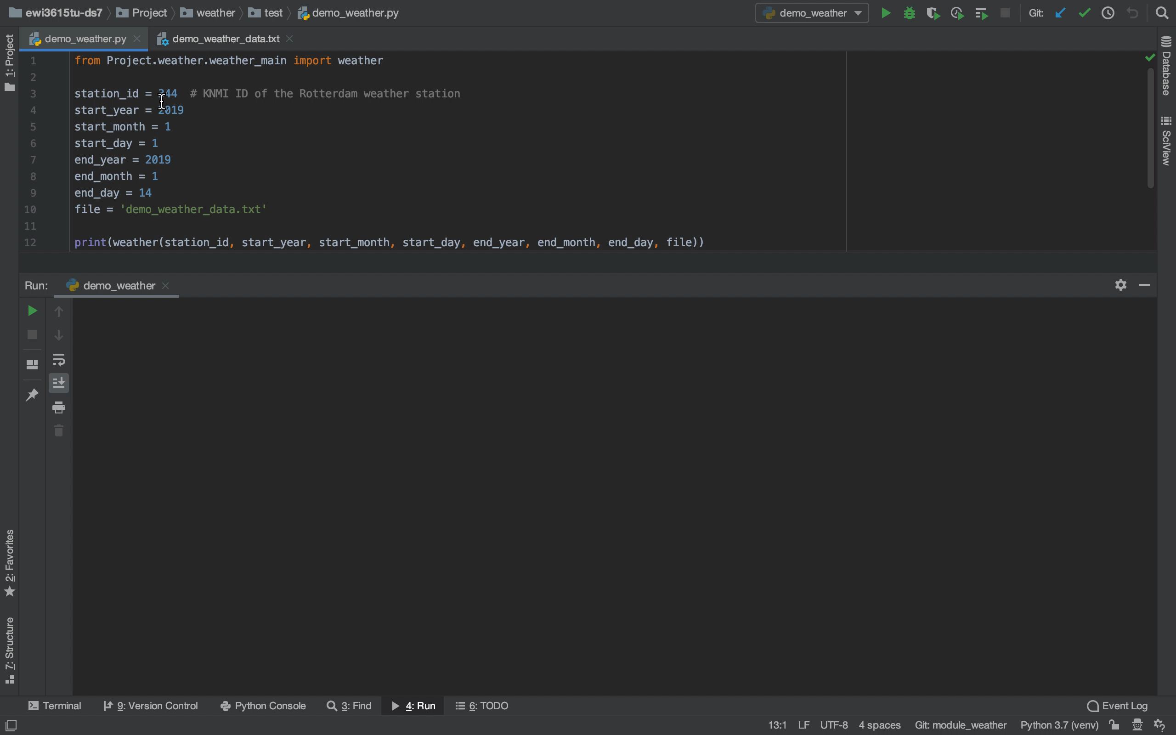
Weather Module
Intro to Strava
Project aim
Design plan
Results
Conclusion
Notes:
Scraped KNMI for this year
Explain the weather types and how the weather scores work

Slide 13
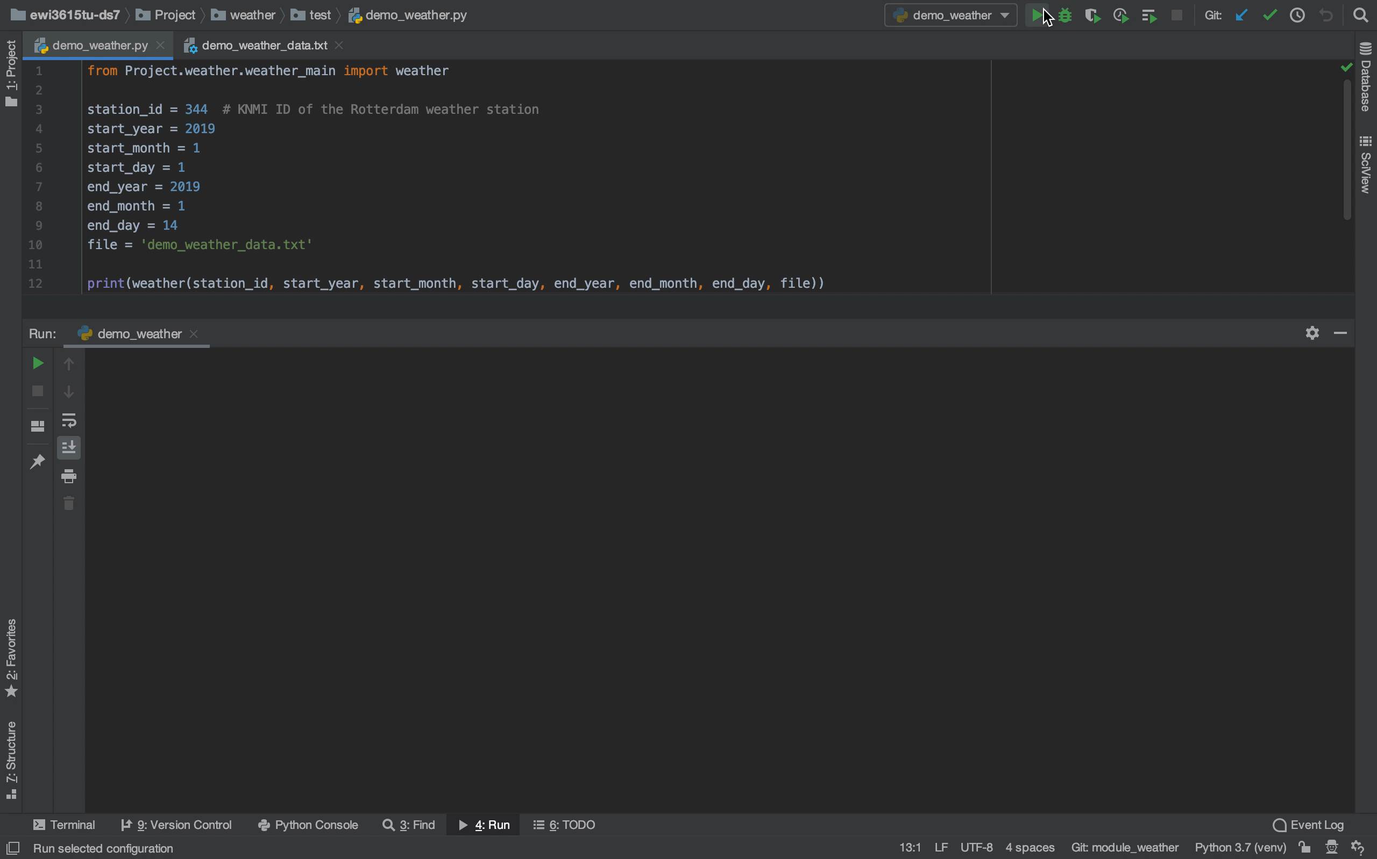
Weather Module
Intro to Strava
Project aim
Design plan
Results
Conclusion
Notes:
Scraped KNMI for this year
Explain the weather types and how the weather scores work

Slide 14

Analysis Module
Intro to Strava
Project aim
Design plan
Results
Conclusion
Filter raw data
Create baseline
Combine Strava activities and weather data

Slide 15
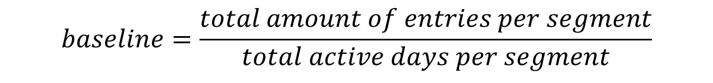
Analysis Module
Intro to Strava
Project aim
Design plan
Results
Conclusion
$$baseline=\frac{total amount of entries per segment}{total active days per segment}$$
Notes:
Mention the baseline of segments where the segment was used only one day by a race! So you got 180 for example.

Slide 16
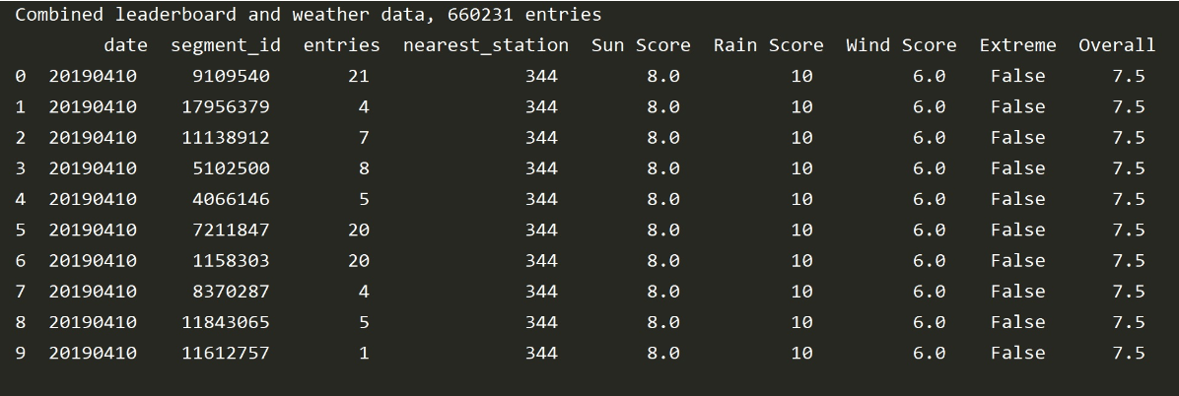
Analysis Module
Intro to Strava
Project aim
Design plan
Results
Conclusion
Weather + Strava:
Combine weather station with segment
Notes:
Two weatherstations in Zuid-Holland, than combine frames based on dates

Slide 17
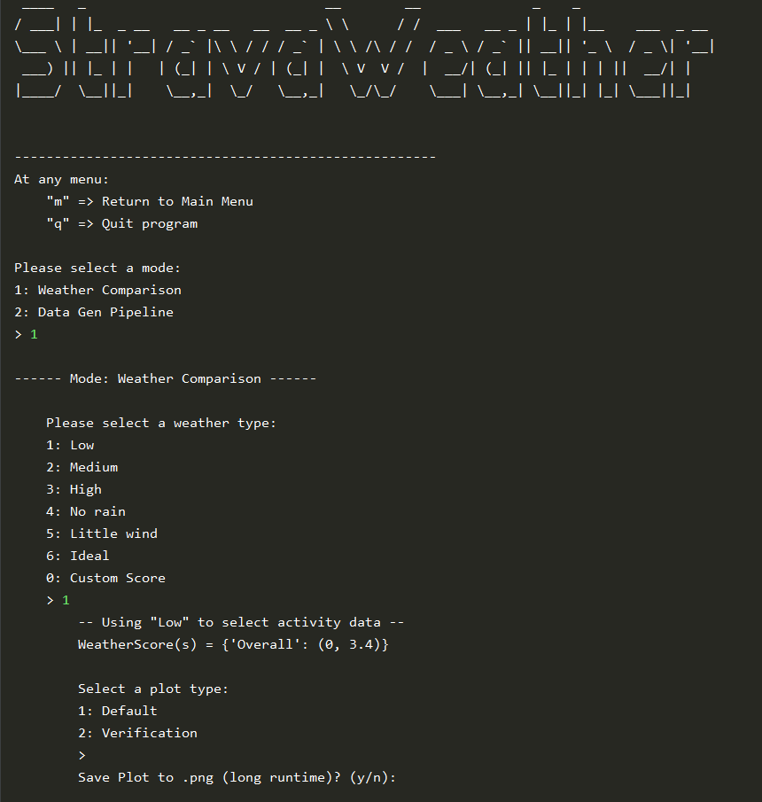
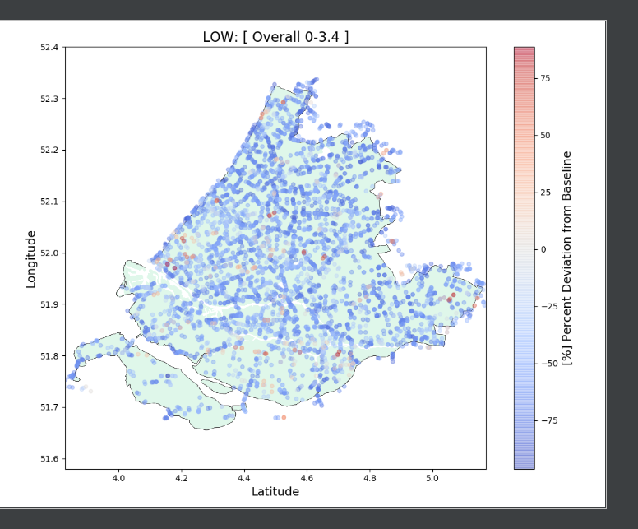
Control Module
Intro to Strava
Project aim
Design plan
Results
Conclusion

Slide 18
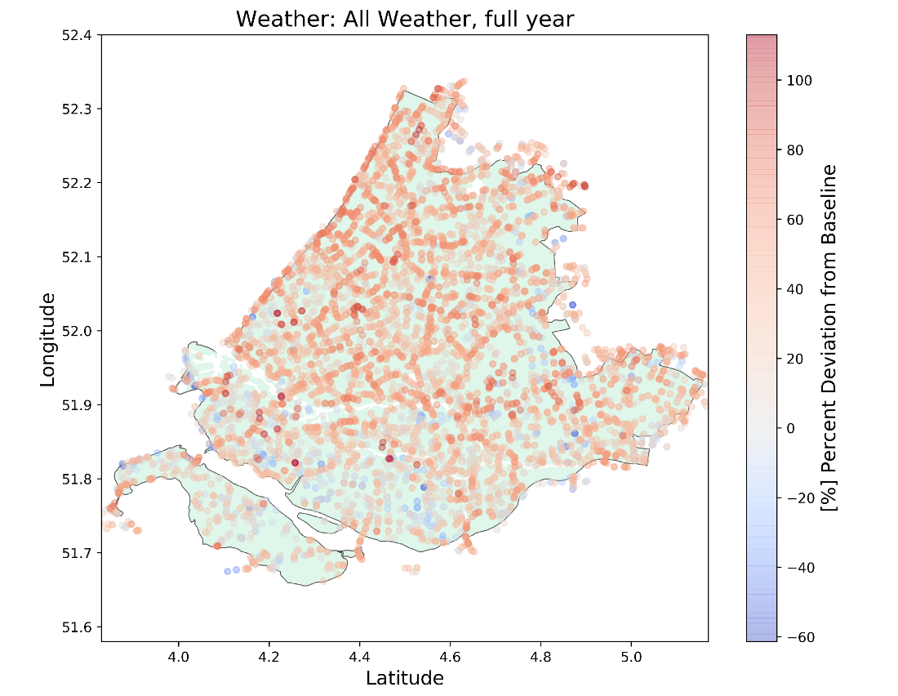
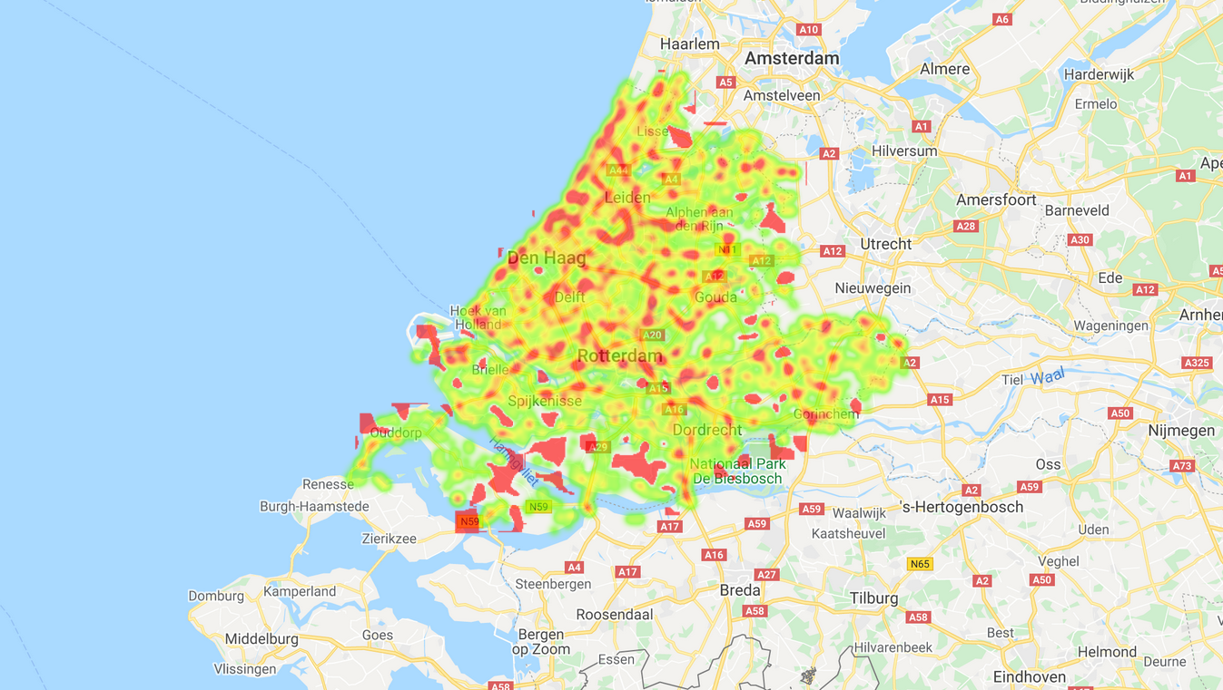
Visualization
Intro to Strava
Project aim
Design plan
Results
Conclusion
Compare selected activities to baseline
Notes:
First used Google but that does not know negative percentage compared to baseline so you would get an odd picture. Switched to matplotlib which does not has this problem and where it is also easier to see the different segments as each segment gets a point
Emphasis that the average is the average per segment of last year per possible weather score/type

Slide 19
Results
Intro to Strava
Project aim
Design plan
Results
Conclusion

Slide 20
Conclusion
Intro to Strava
Project aim
Design plan
Results
Conclusion
Preliminary results hint towards correlation
Needs fine tuning

Slide 21

Lessons learned
Intro to Strava
Project aim
Design plan
Results
Conclusion
Keep output of modules clear
Minimize running time from the start
Allow more time for results analysis

Slide 22
Questions?
???

Slide 23
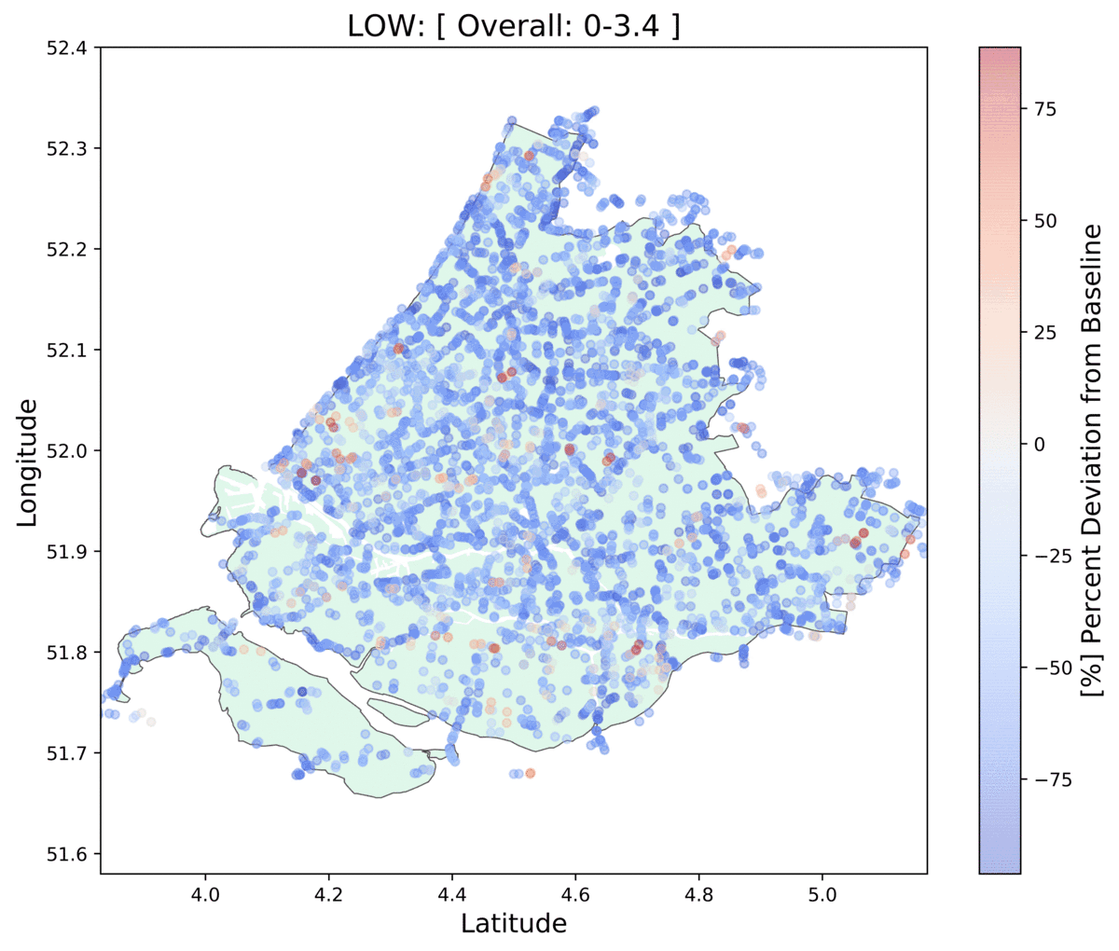
Validation

Slide 24
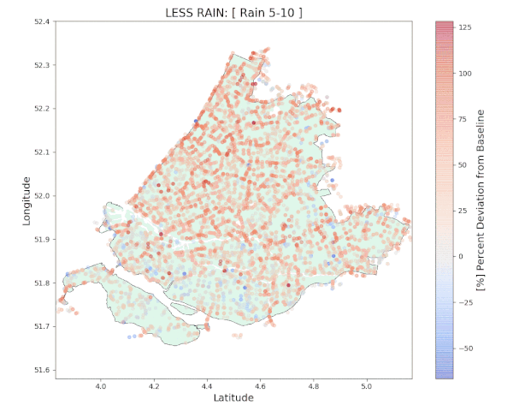
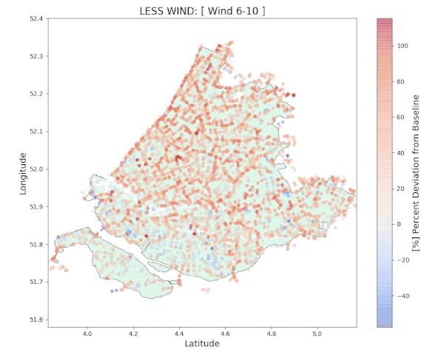
Validation
Rain
Wind

